Slide 1
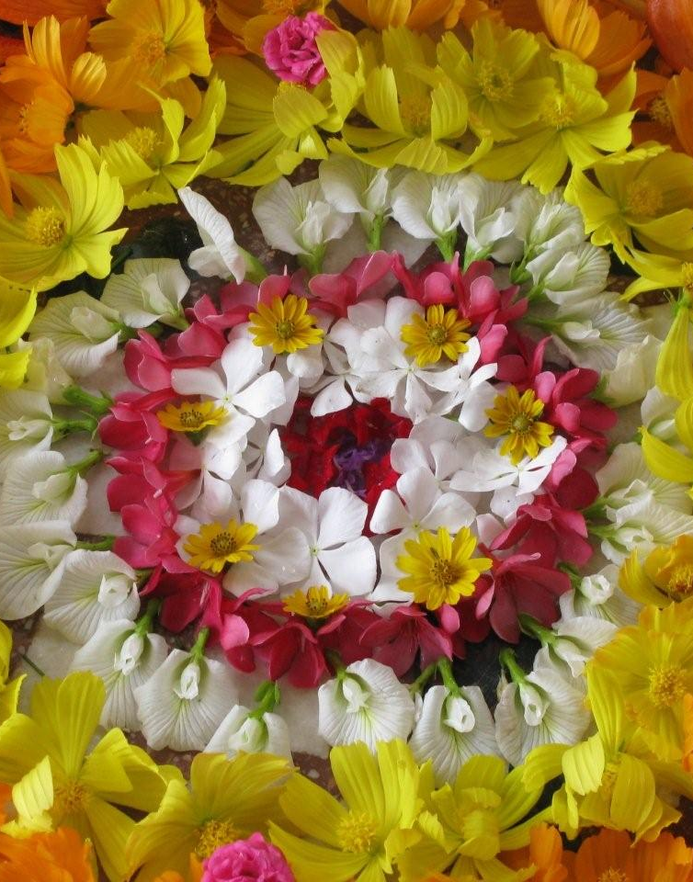

BBA 4th Sem Session 2023-2024 Startup Management Assignment 2
Submitted To:
Ms. Shilpi Upadhyay
Submitted By:
Ashutosh Rathi (AU22C1026)
Tanisha Sitlani (AU22C1019)
Shreyansh Jain (AU22C10)
Shankh Bansal (AU22C1013)

Slide 2

About Krapa (Tera tujhko aarpad kya lage mera)
In an era and generation where there is an ever rising flow of waste and resources are being exploited to their very core . We present to you an environmentally sustainable organisation Krapa, At krapa we try to reutilise these leftover resources again and create other bi products from them while maintaining them in their original and uncompromised state and bring them back into the system of reusability which in turn also increases their longitivity and reduces further waste disposal. The process begins where we collect these discarded flowers from the temples. We then on sort, clean, and sun-dry them, preserving their natural fragrance and essence. Using traditional methods passed down through generations, we blend them with oils and other ingredients to create incense sticks and Dhupbatti that are not only fragrant but also eco-friendly.

Slide 3
Problem Statement
Problem cases with temple flowers can vary depending on the context. However, the issue usually involves the management or disposal of flowers used in religious shrines or ceremonies. Temples often receive many flowers as offerings, and the challenge is what to do with these flowers after they have been used in worship The main themes of temple flowers are as follows:
Waste: Once used in ritual or worship, flowers decompose and become garbage. The removal of these blooms can cause environmental problems if not properly managed.
Environment: Improper disposal of litter, such as dumping it in rivers or landfills, can cause pollution and harm ecosystems.

Slide 4
Road Map Of The Assignment
Problem Statement
Description of the Idea
Why This Idea
Key Stakeholders
SWOT (Before Survey)
Questionnaire
SWOT (after Survey)
Feasibility Study
Budgeting
Business Model Canvas
Glimpes

Slide 5
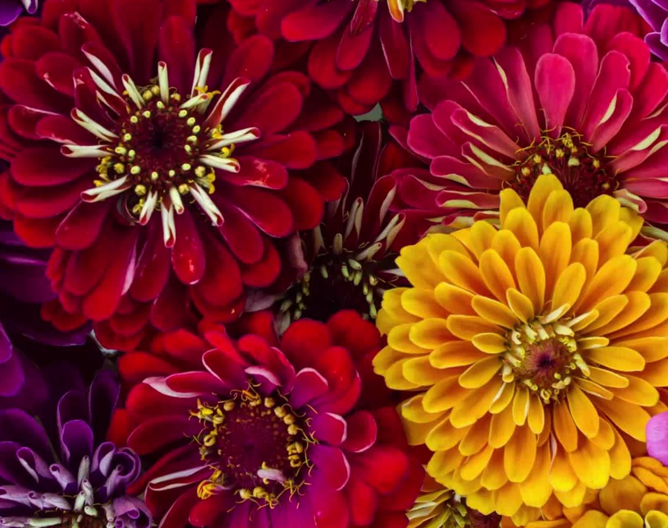
Description of the Idea
Efforts are made to address these challenges through initiatives like composting, creating Inset sticks, Gulkand, Holi color, Fragrances, Soap, Etc. or converting flowers into bio-fertilizers. The goal is to find eco-friendly ways to manage temple flowers that respect their significance in religious practices while reducing environmental impact.

Slide 6
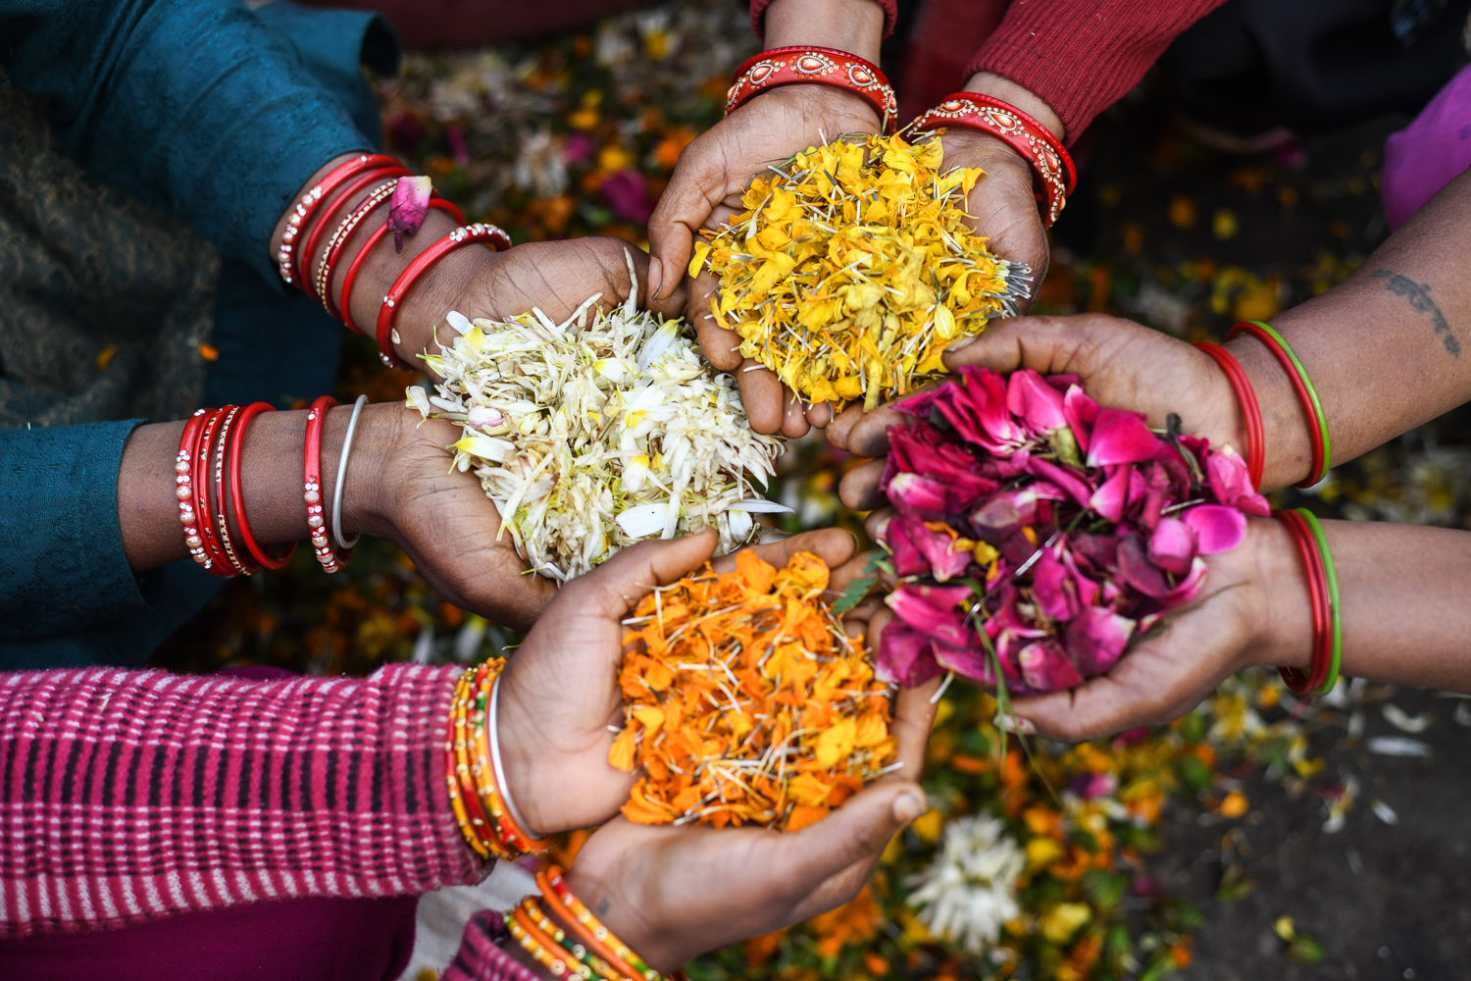
Product Line
Inset sticks
Soap
Bio fertilizers
Compost
Fragrances
Holi Color
Dhup Batti
Gulkand

Slide 7
Why this Idea
Environmental Impact: Temples get a lot of flowers every day, and when these burn down, it can create a lot of garbage. Improper disposal can lead to water discharges, soil erosion, greenhouse gas emissions and other environmental problems if they occur in landfills
Cultural significance: Flowers used in religious ceremonies have cultural and spiritual significance. The respectful treatment of their garbage is consistent with the respect people have for these religious symbols.
Public Health: Flower rot can attract insects and pests, which can pose a health hazard. The use of garbage helps maintain cleanliness and hygiene in and around the church premises.
Economic Opportunities: Recycling flower waste can create economic opportunities through recycling, such as flower compost or natural chemical fertilizers.

Slide 8
Production Process
Collecting of Flowers
Segregating them
Taking petals out of flower
Drying them
Grinding them
Filtering
Adding Essential substances
Making batter out of it
Rolling inset sticks.

Slide 9
Key Stakeholders
Temple Authority
Government Bodies
Farmers
Social Media
Market (Shopkeepers, wholesalers, retailer).
NGO

Slide 10
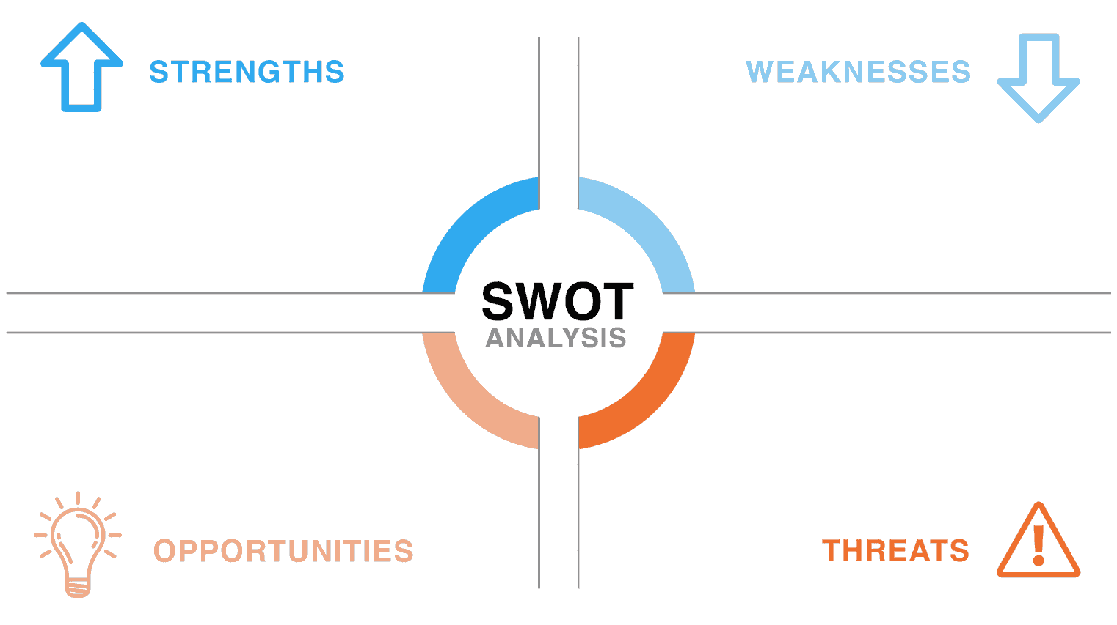
Cultural Preservation
Sustainability
Community Engagement
Economic Opportunities
Environmental Impact
Innovation and Creativity
Lack of Infrastructure
Health and Hygiene Concerns
Sustainability Issues
Cultural Sensitivity
Community Engagement
Before Survey
Educational Opportunities
Innovation
Economic Potential
Entrepreneurship
Limited Awareness
Cultural Sensitivity
Chemical Contamination
Health Hazards
Easily Copyable
Government Policies

Slide 11
Questionnaire
What is the current process for handling temple flowers after use?
1
Are there any existing methods for managing flower waste?
2
How is the flower waste currently disposed of?
3
Have there been any efforts to reuse or recycle these flowers?
4
Are there any concerns about the impact of flower waste on the environment?
5
Do the used flowers hold any specific spiritual or cultural significance?
6
Are there any potential opportunities for improvement or innovation in this area?
7

Slide 12
Long-Term Sustainability
Eco friendly
Respectful Approach
Implementation Support
Knowledge Sharing
Traditional Constraints
Lack of Resources
Limited Awareness
Inadequate Collaboration
Short-Term Focus
After Survey
Education & Awareness
Adapting Rituals
Symbolic Significance
Community Involvement
Cultural & Spiritual Guidance
Resistance to Change
Limited Resources
Knowledge and Awareness
Community Expectations

Slide 13
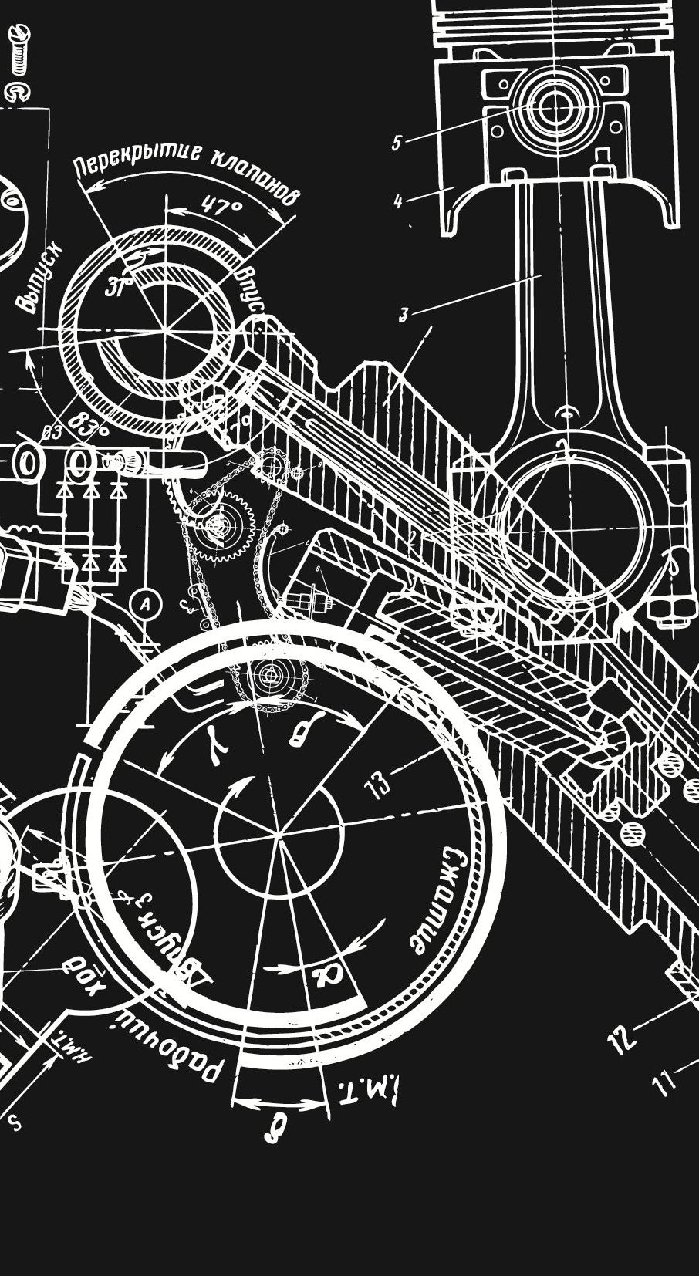
Technical Feasibility Study
A technical feasibility study for temple flower management examines waste processing methods, composting, extraction techniques for soaps and fragrances, and the infrastructure required for recycling. It evaluates the practicality of these methods within the temple's resources and constraints.

Slide 14

Economic Feasibility Study
Repurposing temple flower waste offers economic viability through the production of marketable products like soaps, incense sticks, and natural dyes. Composting generates cost-effective biofertilizers. These initiatives not only manage waste sustainably but also create revenue streams, fostering economic feasibility for temple flower management systems.

Slide 15

Operational Feasibility Study
An operational feasibility study for temple flower management assesses the practicality of implementing waste recycling, composting, and product creation from flowers. It evaluates infrastructure, resource availability, and community participation, ensuring the viability of sustainable practices while respecting cultural sentiments.

Slide 16
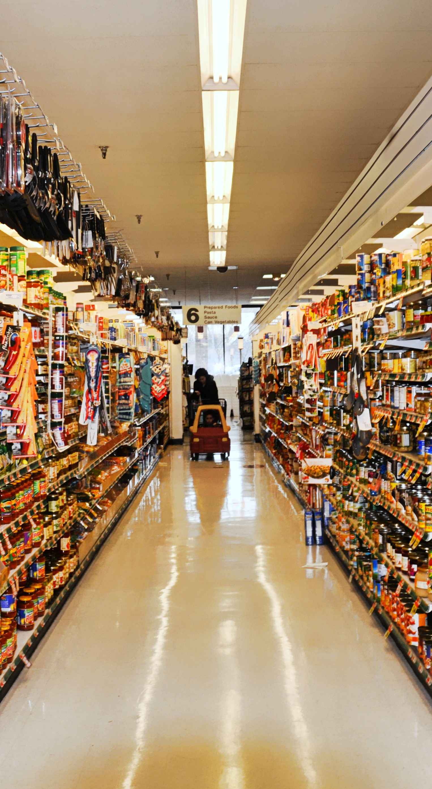
Market Feasibility Study
A market feasibility study for temple flower management indicates a strong potential for sustainable products like incense sticks, soaps, and compost. The market demand aligns with eco-friendly products, offering opportunities for cultural and environmentally conscious consumers, fostering a viable and promising market landscape.

Slide 17

Capital Funding
Capital finance is important in the evaluation of the project because it provides the financial resources needed to implement and sustain projects. Adequate capital funding ensures that businesses have the necessary financial support for initial investments, operating expenses, and possible future expansion. It plays a vital role in the success of the project by enabling timely execution of services, procurement and effective management. Lack of capital can lead to delays, poor quality, and even project failure. Thus, in order to realize the envisaged benefits, it is necessary to generate sufficient funds to meet the objectives given in the project evaluation.
Total Cost = 1000 Rs(for 1 kg)
Variable = 400 Rs
Fixed = 600 Rs

Slide 18

Capital Budgeting (1 Kg)
Budget allocation in capital budgeting involves distributing financial resources to different areas or projects within a company, So for This project to take their business the budgeting will be as follows:
Labour cost = 300 Rs
Raw Material = 200 Rs
Machinery = 100 Rs
Packaging = 200 Rs
Marketing = 200 Rs
Total Budget Required = 1,000 Rs

Slide 19
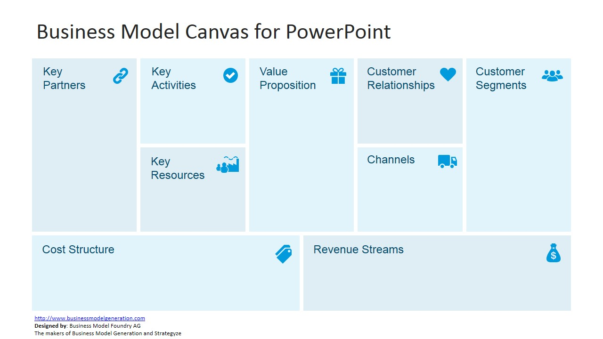
Supply Chain Development
Marketing
Production
HR Management
Temple
Household
Shopkeepers
Farmers
NGO
Eco Friendly
Best From Waste
Affordable
Employment Generation.
Feedback structure
Customer support
Temple
Farmers
Wholesalers
International Market
Digital Marketing
Wholesalers
Retails
B2B
NGO
Brand
Network of workers
Workshop
Packaging
Raw Material
Employee
Marketing
Packaging
Machinery
Maintenance
Warehousing
Technology
Sales

Slide 20
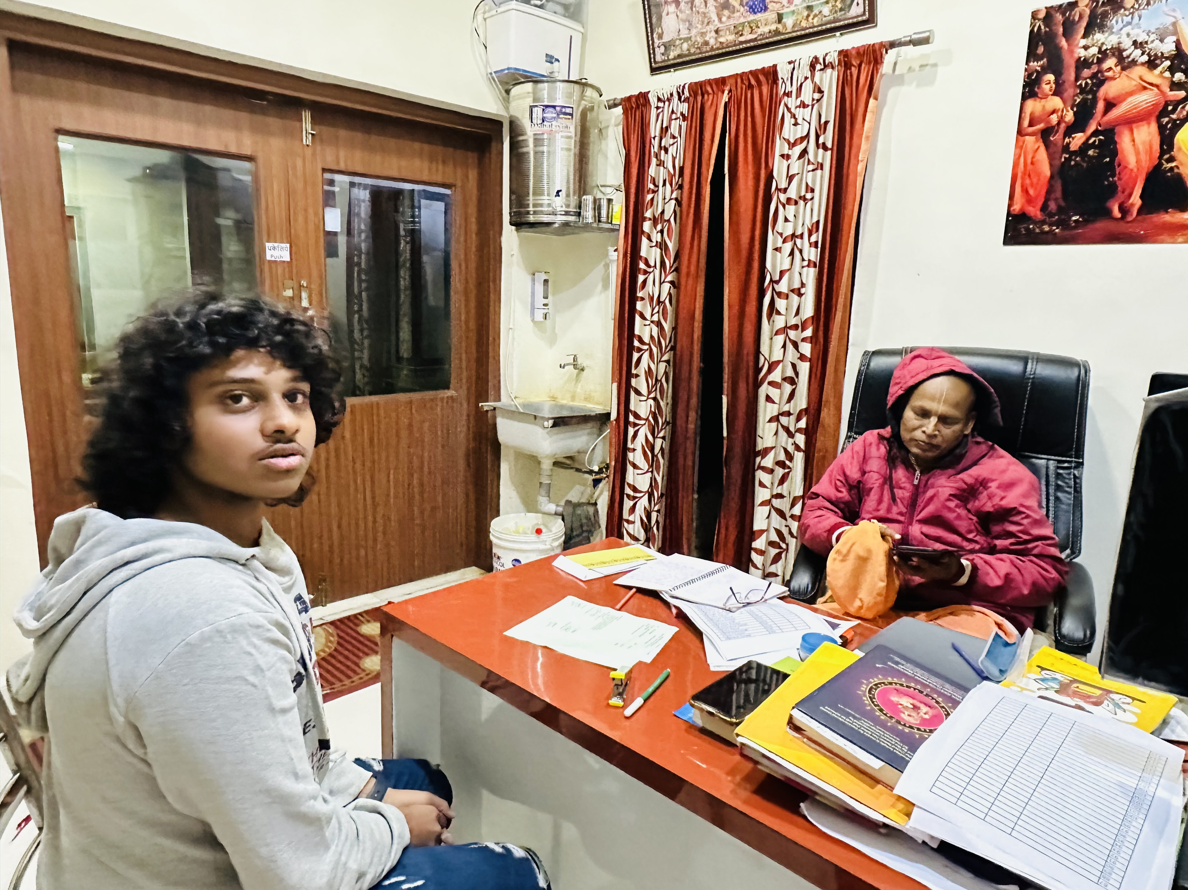
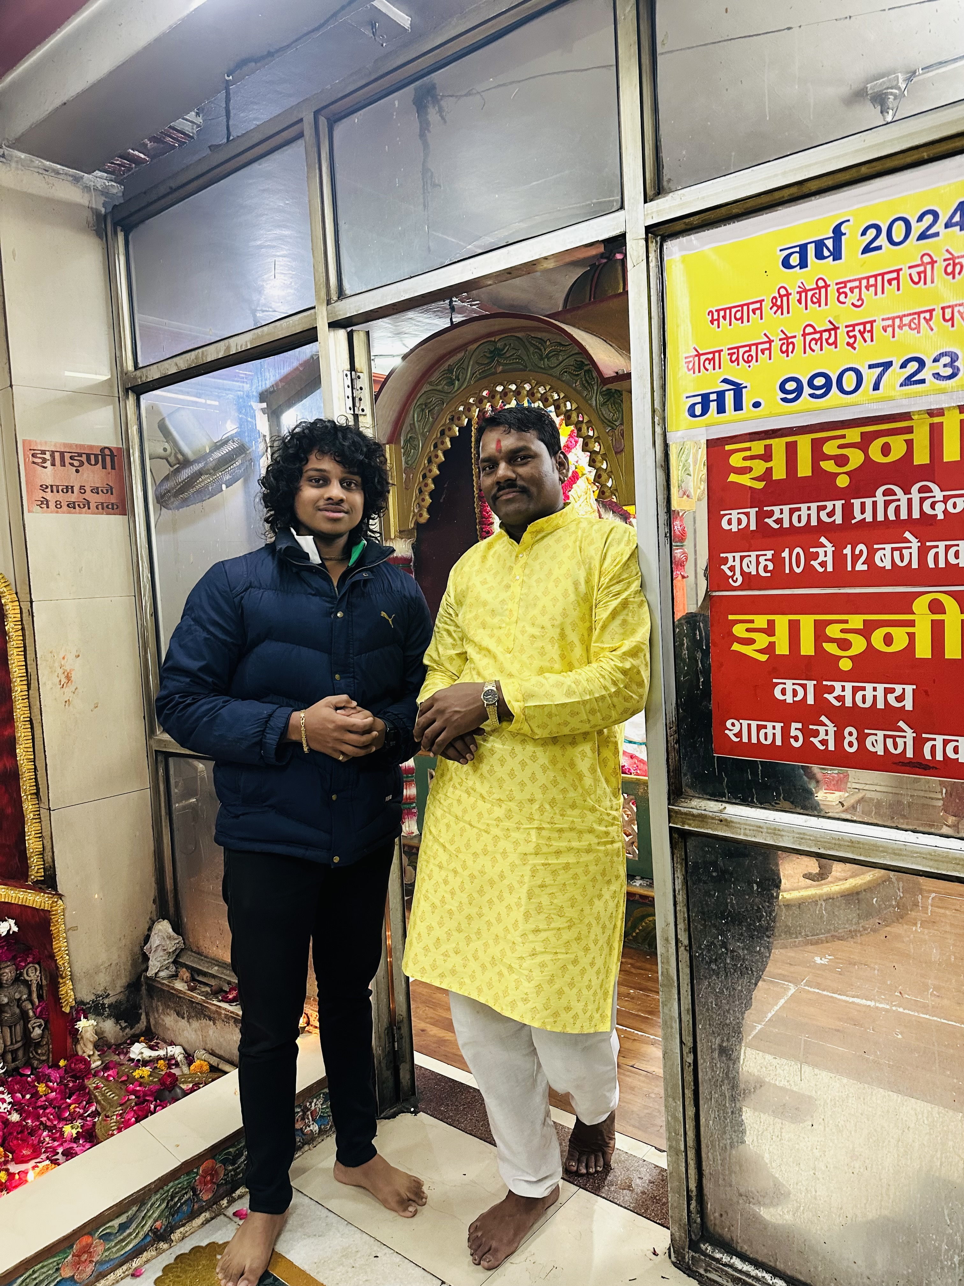
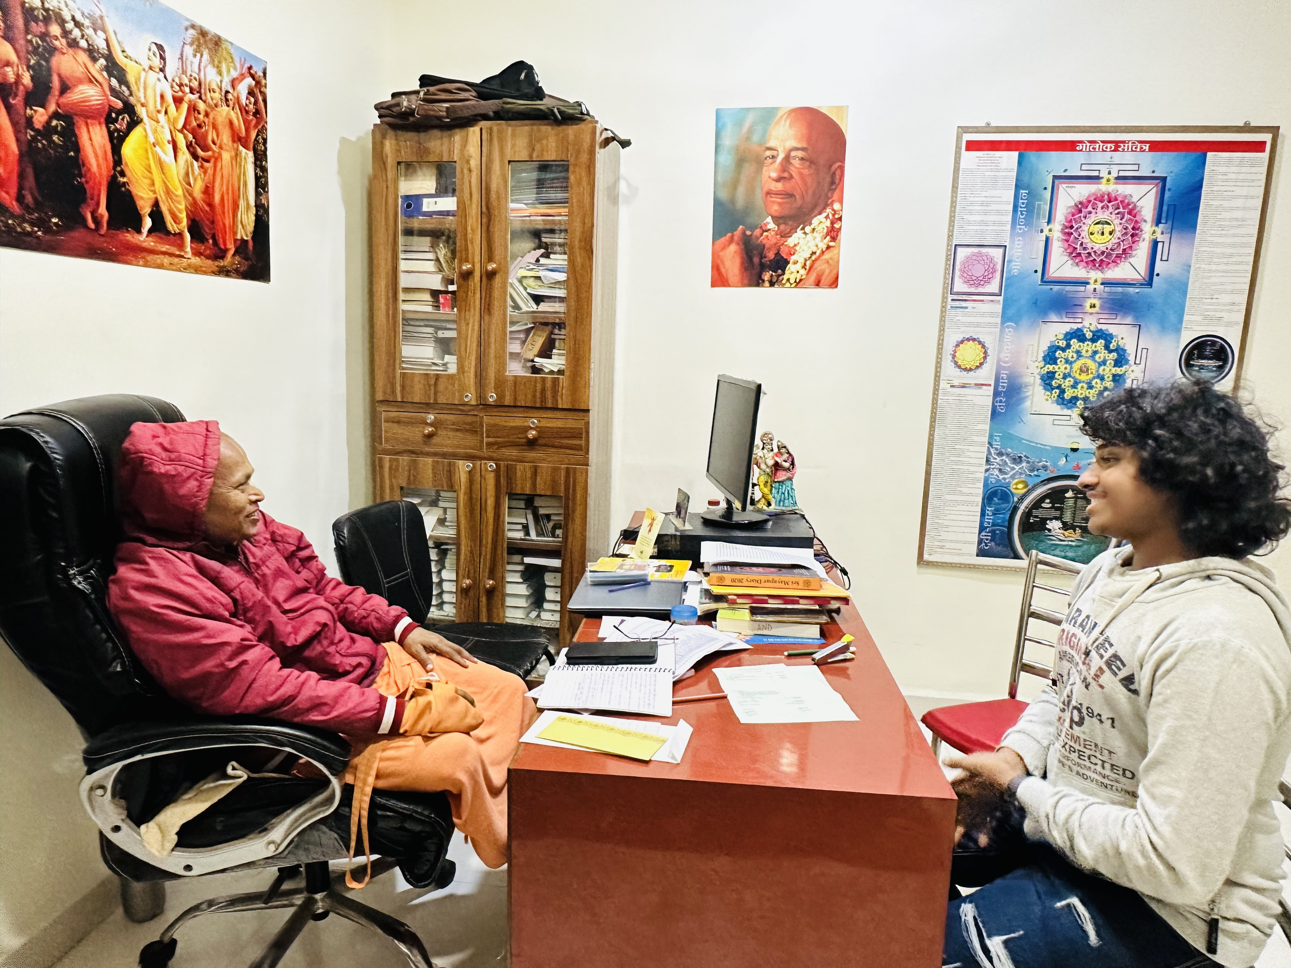
Glimpse

Slide 21
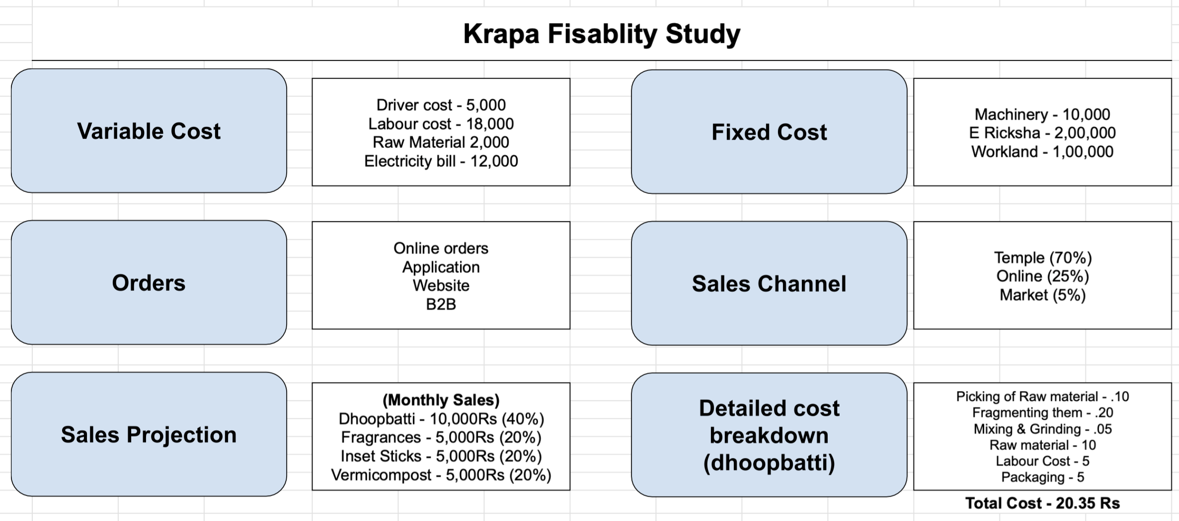

Slide 22
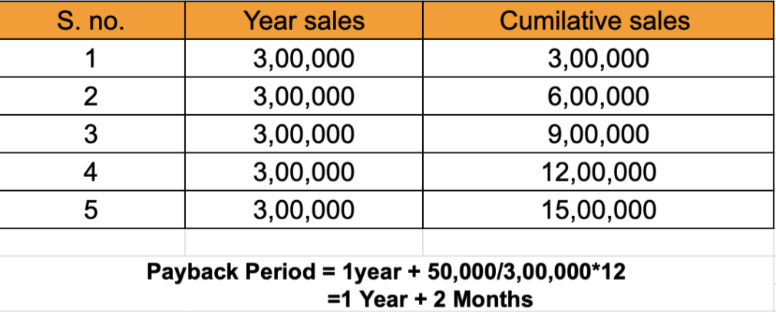
Payback Period
Total investment = Fixed cost + Variable cost = 3,50,000
Monthly sales = 25,000

Slide 23
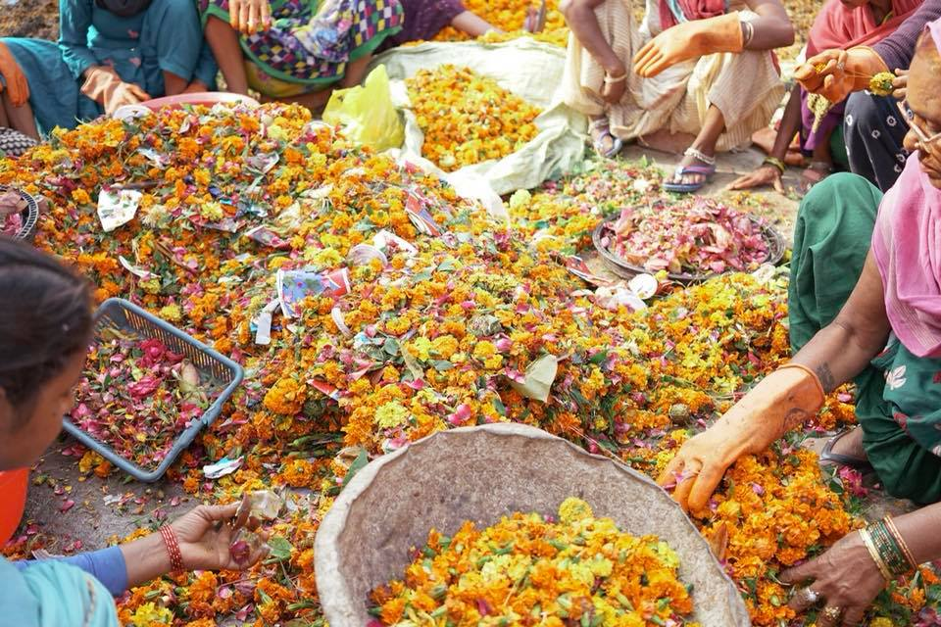
USP of Krapa
Eco-Friendly Elegance Made from recycled flowers, our product reduces waste and embraces nature’s beauty, it’s a sustainable approach.
Pure Organic Essence: 100% organic ingredients ensure a chemical-free experience, promoting health and wellness with every use.
Bouquets: Immerse yourself in floral elements, as our product captures the delicate scent of recycled flowers.
Craftsmanship: Each piece is meticulously crafted, with a unique aesthetic, and showcases the masterful craftsmanship behind each piece.
Positive Impact: When you choose our product, you contribute to the circular economy by supporting environmental sustainability and fair production practices.

Slide 24

Clear Market of Krapa
Mission: To create eco-friendly and spiritual incense sticks and Dhupbatti from repurposed temple flowers, promoting sustainability and fostering a deeper connection with divine traditions.
Spiritual Consumers: Individuals seeking natural, organic, and ethically sourced incense products for prayer, meditation, and aromatherapy.
Eco-Conscious Consumers: People concerned about environmental impact and interested in sustainable alternatives to traditional incense.
Temples and Religious Institutions: Temples looking for responsible ways to manage floral waste while aligning with their values.

Slide 25

Advertisement plan
Social Media Campaign
Online Platforms
Educational Webinars
Packaging Message
Branding Message

Slide 26
Marketing Campaign
Krapa ka naya andaaz,
Phoolon ki sajawat, kachre se! Le aao ghar mei Krapa ki khusbu, Swachh aur Sundar

Slide 27
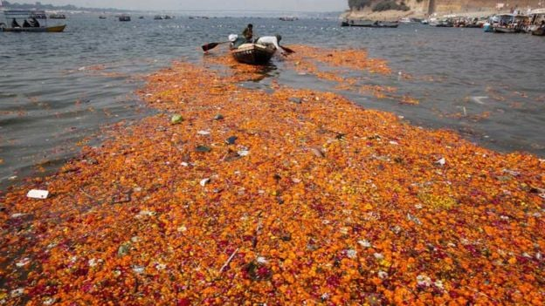
Summary
Church flower waste management offers a variety of innovative and sustainable solutions. Flowers used in religious ceremonies can be repurposed for a variety of useful purposes. High in natural oils, these flowers are good for scented soaps, incense sticks (agarbatti), and perfumes, reducing waste and providing pleasant aromas Through processing, flower gardens contribute to the production of incense batti, famous for its religious significance and calming qualities.
Additionally, the vibrant colors of these flowers can replace the natural pigments used in dyed and handmade textiles. After composting, these flowers are converted into nutrient-rich material, which fertilizes the soil and supports sustainable agriculture In addition, the sweet leaves are used to make cauliflower , a delicacy appreciated for its flavor and medicinal properties. These programs not only efficiently manage church flower waste but provide economic opportunities and environmentally friendly alternatives while respecting the cultural significance of these dignified graces.

